Slide 1

DJANGO STARTER COURSE
Notes:
Hello and welcome to the 'Django Starter Course’! I am thrilled to have you here today.
Whether you're new to programming or an experienced developer, this course will provide you with the knowledge you need to start building web applications using Django, a powerful web framework written in Python.
Why Django, you might ask? Well, the beauty of Django is that it's designed to help developers take an idea and turn it into a fully-functioning web application as quickly as possible. It's secure, scalable, and follows the DRY (Don't Repeat Yourself) principle to ensure your code is clean and efficient.
Over the next lessons, we'll be diving into the essentials of Django, starting from the basics of setting up a new project to understanding the MVT (Model-View-Template) structure, working with databases, creating user-friendly forms, and finally deploying a complete web application.
Remember, the key to mastering Django, like any skill, is patience and consistent practice. So don't worry if you don't understand something on the first try.

Slide 2
Bridging Theory and Practice: A message for PoliTo Students
Notes:
Before continuing I would like to stop here a bit, and share this message with the students from Politecnico di Torino.
You're part of an esteemed university in the field Computer and Engineering. Your education here provides you with a powerful foundation in programming concepts and practices, but you may be asking yourself, 'How can I use this knowledge in practical, real-world applications?’
We’re here today to provide one exciting answer: web development with Django! This Python-based framework enables us to build dynamic, robust and secure websites in a streamlined and efficient manner. By learning Django, you'll take a significant step in translating your academic knowledge into practical skills.
Today, we will not only delve into the principles of Django, but we'll also see how we can use it to start building a compelling portfolio. This includes creating your own projects, which can be a significant differentiator when you're looking to start your career or even if you're aiming to work on your own start-up.
So, get ready to explore the world of Django, and let's start this wonderful journey of turning ideas into functional, live websites.

Slide 3
What do you need for this course?
Python Basic knowledge and programming abilities
Front-End basic Skills ( https://www.w3schools.com/html/default.asp )

Slide 4
Why Python?
Easy to Learn
High level language
Powerful Libraries
Readability
High demand in job market
Notes:
Easy to learn: Python has a clean and easy-to-understand syntax, which makes it perfect for beginners.
High-level language: It is a high-level language which allows you to focus on what to do instead of how to do it.
Powerful libraries: Python has extensive libraries for scientific computing, data analysis, machine learning, web development, and more.
Readable: Python's clear and readable syntax makes it easy to understand, even if you are not the original author of the code.
High demand in job market: Python developers are in high demand in today's job market, making it a great skill to learn.

Slide 5



Introducing Django
Web framework
Follows MVC pattern
BATTERIES INCLUDED
DRY PRINCIPLE ‘Don’t Repeat Yourself’
ORM Support
Scalability and Security
Used by industry giants
Notes:
Web Framework: Django is a high-level Python web framework that allows for rapid development and clean, pragmatic design.
Follows MVC pattern: It follows the MVC (Model-View-Controller) architectural pattern, making it easier to understand and maintain your code.
Django does indeed follow the Model-View-Template (MVT) architectural pattern, which is a variant of the classic Model-View-Controller (MVC)
Batteries Included: Django follows the philosophy of 'batteries included', providing almost everything developers might want to include in their web application.
DRY Principle: Django is based on DRY (Don't Repeat Yourself) Principle. The main goal of the DRY principle is to reduce the repetition of code.
ORM Support: Django includes a powerful ORM (Object Relational Mapping) layer for database access.
Django is designed to help developers take applications from concept to completion as quickly as possible, and it can scale to handle very heavy traffic loads.
It helps developers to avoid many common security mistakes by providing a framework that has been engineered to "do the right things" to protect the web application.
Used by Industry Giants: Many significant platforms, including Instagram, Pinterest, and The Washington Post, have been built with Django.

Slide 6

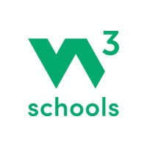
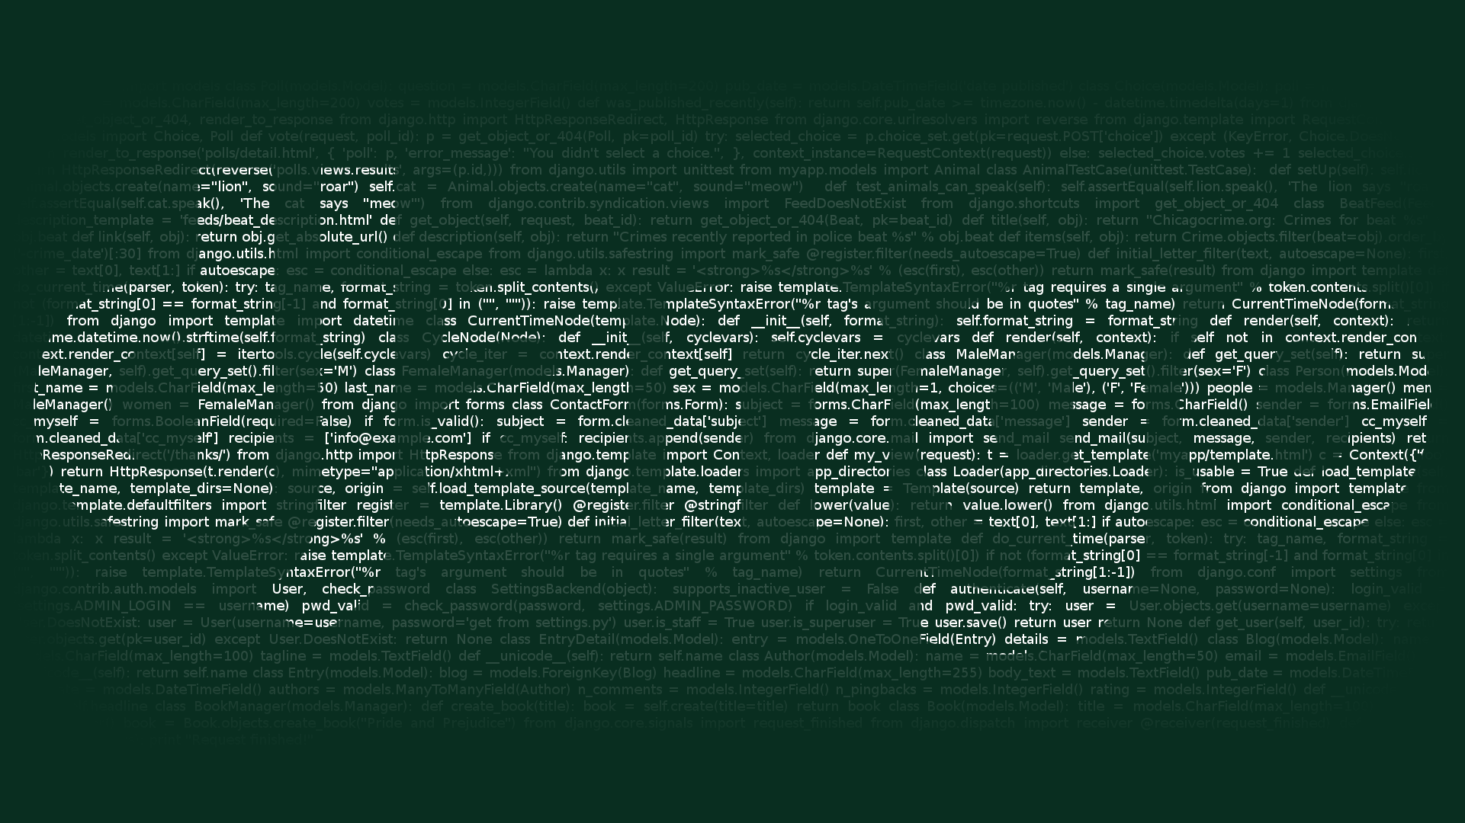
References
(W3Schools) https://www.w3schools.com/django/index.php
(Django Official Documentation) https://docs.djangoproject.com/
(Django Packages) https://djangopackages.org/
Notes:
Mainly in this course, we’ll refer to the first two links, the open-source free w3schools written course in Django, and the official documentation of Django.
So if you prefer to learn by reading, it is highly recommended to go to the first link and start the course as this course is prepared using the resources that can be found on the first link.
For the third reference, since we are not going to use any Django package in this starter course we do not need it, but later in the upcoming courses (where we are going to build complete projects), we will use a lot of Django packages, and we will discuss there about these amazing Django packages.

Slide 7
Let’s START!
Notes:
Thank you so much, and let’s start!

Slide 8
What you’ll learn

